Slide 1
INSIGHTS FROM REVIEWS
BRITISH AIRWAYS
PRESENTATION BY EMMANUEL DE-GRAFT

Slide 2
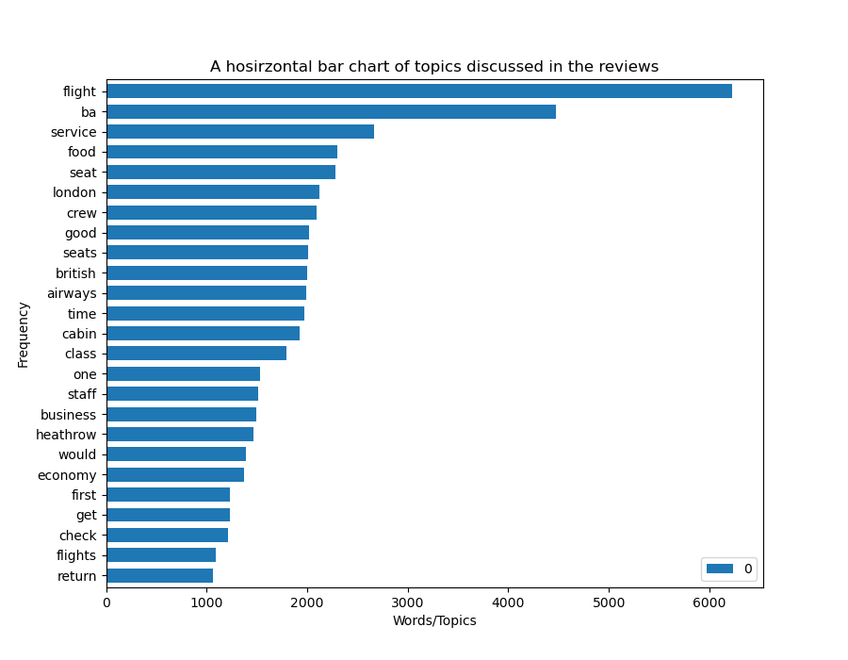
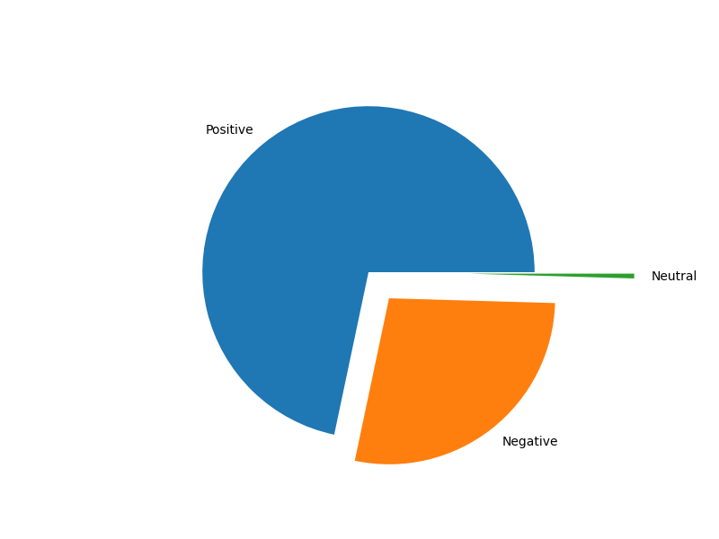
Insights from British Airways reviews: Sentiment Analysis and Topic Modelling
Topic Modelling
Sentiment Analysis
71.7%
0.5%
27.8%
Out of 3476 reviews, 2492 were positive, 968 were negative and 16 were neutral. Thus most of the reviews were segregated into positive and negative.
The chart above depicts the frequency of topics in the reviews which include but not limited to “flight”, “service”, ”food”, ”seat”. Customers talked about the inflight service, especially food.

